Slide 1
Kai patel
Building my confidence & Rediscovering my self-worth with westcombe Engineering

Slide 2
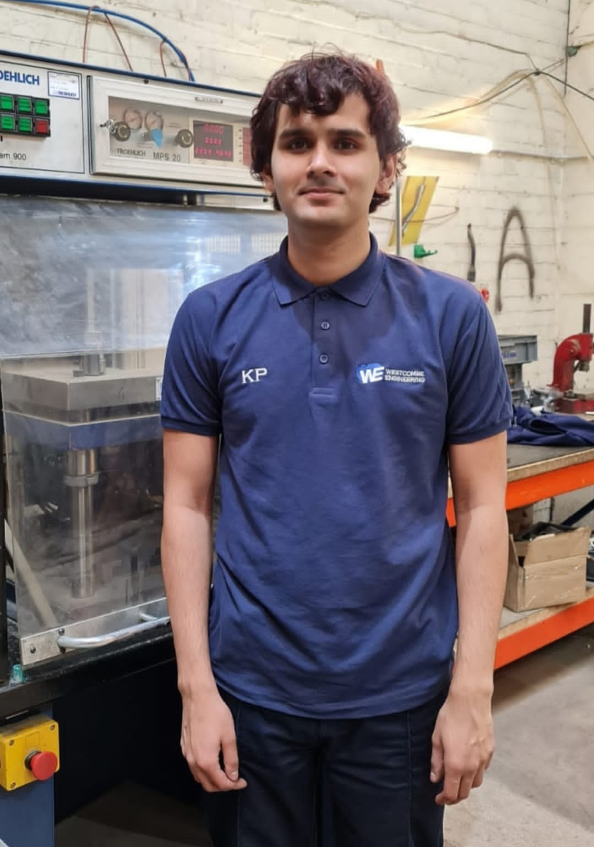
Getting to know me
I am 22 years old and a huge Pokémon fan (sometimes walking 200KM or more a week)!
I am autistic and I struggle with complex social interactions and I often feel awkward around people. Interpreting other people’s emotions and working out their expectations of me is a challenge. I worry a lot about things.
I am intelligent and did well in my GCSE’s, but I dropped out of sixth form as I struggled to deal with the social environment, pressure and change
My mental health is sometimes fragile, and I often have difficulty dealing with life’s challenges and I have experienced a lot of anxiety and depression over the last 7 years. I don’t always know how to respond to situations.
I joined the Princes Trust Programme (Peterborough City Council Youth Team) and this helped me to get back on my feet and gave me the confidence to look for work
Learning to live & work with autism is a daily challenge BUT I keep going. I often need a little help & support!
My first job was in retail (toy store). I worked there for a year and this helped me to develop my customer service skills, but I had a period of poor mental health and had to leave.
I got a job as an apprentice in digital media but sadly, they made me redundant the day I got my certificate, and this was a shock that I struggled to deal with.
I found another job, but the pressure was too much, and I had anxiety attacks leading to them letting me go. I picked myself up and after completing my induction at a new company I was let go again due to COVID. I was devasted. 10 months later I tried to work again but couldn’t cope. My health and confidence were now at an all-time low BUT I really needed a job and wanted to work but I just couldn’t cope with the change or routine and environment.

Slide 3
WHY WORKING AT Westcombe engineering IS GREAT for me………
Encouraged | Supported | valued
I GET NERVOUS ABOUT DOING THINGS WRONG BUT I GET A LOT OF REASSURANCE HERE | I FEEL COMFORTABLE TO ASK QUESTIONS AND TO TELL THEM HOW I FEEL AND WHAT I NEED | I FEEL THAT PEOPLE ARE INTERESTED IN ME AND MAKES ME FEEL PROUD TO BE PART OF THIS TEAM
I THINK ANDREW & THE TEAM REALLY CARE ABOUT THE STAFF HERE AND WANT US TO BE HAPPY IN OUR WORK. THAT ENCOURAGES ME TO TRY NEW THINGS EVEN WHEN I AM ANXIOUS | THEY TAKE THE TIME TO EXPLAIN & CHECK I KNOW WHAT IS EXPECTED OF ME. I FEEL SAFE & CONFIDENT TO SHOW WHAT I CAN DO | THE STAFF SET ME GOALS EVERY DAY, EXPLAINING HOW MY WORK HELPS THE BUSINESS. I FEEL VALUED & USEFUL

Slide 4
“I feel supported here…people take the time to understand me and my needs…I can be myself……. I don’t feel judged! I am able to take things at my pace…I can take 1 large step or 10 small steps it’s okay to do it my way…I don’t feel rushed!”

Slide 5
Before
The Difference 6 weeks makes!
NOW
I am going to work every day arriving with a smile and leaving with a smile.
I am beginning to believe that working and being independent is something I can do and deserve. I am starting to look forward to my future again
I do sometimes still get anxious but when I do feel like that, I take a little bit of time out and try again.
I am learning new things every day…..I feel good about myself
I feel that I am doing useful things every day…helping the team at Westcombe and I am beginning to make friends at work
I have just moved out on my own….6 weeks ago I would not have been confident enough to live on my own. I am working hard hoping my placement will lead to paid employment at Westcombe Engineering.
I was extremely anxious
I found it hard to talk to people
I felt worthless
I couldn’t see how I would get another job, starting somewhere new was so frightening
I was depressed and struggled to see a future for myself
I was staying in most of the time and not getting much exercise. I felt anxious leaving the house

